Slide 1

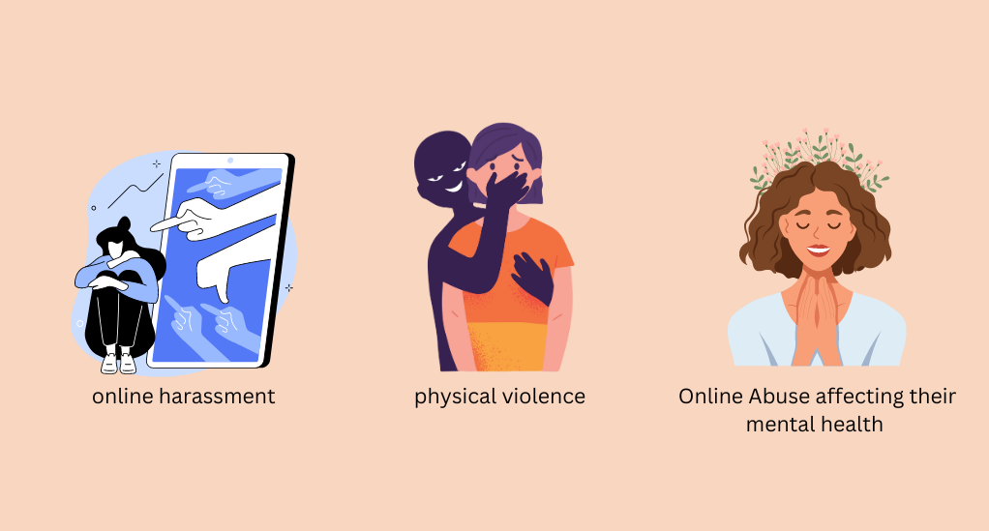
Online Harassment and Threats Through A Gender Lens
Shaka Mirtskhulava

Slide 2

Cyberbullying is when someone uses technology for bulling
Name-calling and insults, often targeted at someone’s gender or appearance.
Spreading lies or rumors online.
Sharing personal or private information without permission.
Sending threats or hurtful messages and even excluding someone from an online group or game on purpose.

Slide 3

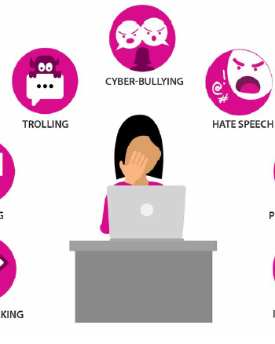
Cyber Harassment prevalence in Gender

Slide 4
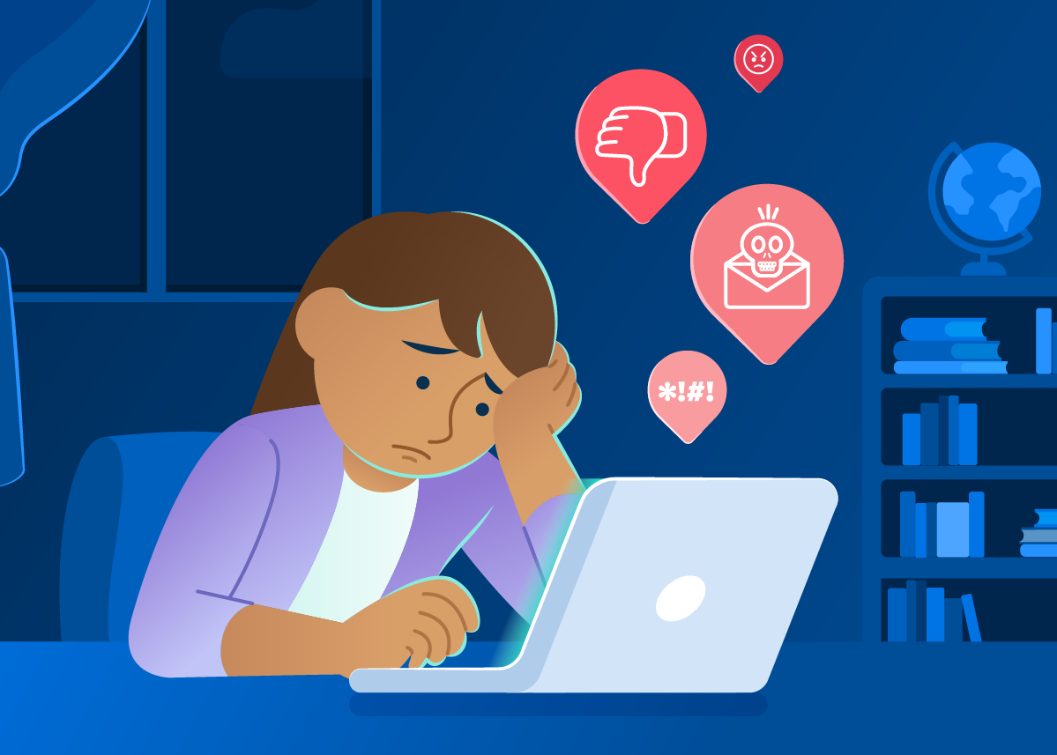
Cyber Harassment Prevalence in Gender
Sexual comments, threats of violence, or are told they shouldn’t be online at all.
For women, the abuse usually focuses on their looks, their role in society, or tries to silence them when they speak out.

Slide 5

In many cases, men experience harassment too, but the type and reason are often different. For women, the abuse usually focuses on their looks, their role in society, or tries to silence them when they speak out.
Men Harassment

Slide 6
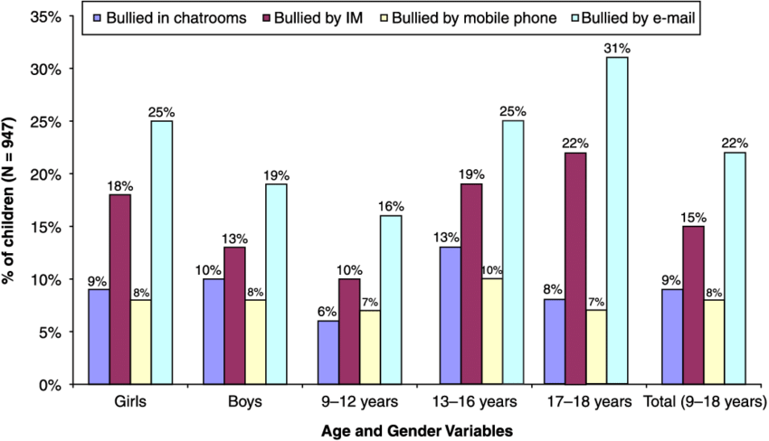
Statistics and Prevalence
According to the official website of United Nations: Over a four-year period, from the analysis of 19 million tweets, a Ditch the Label and Brandwatch report found that there were almost 5 million cases of misogyny on Twitter alone..

Slide 7
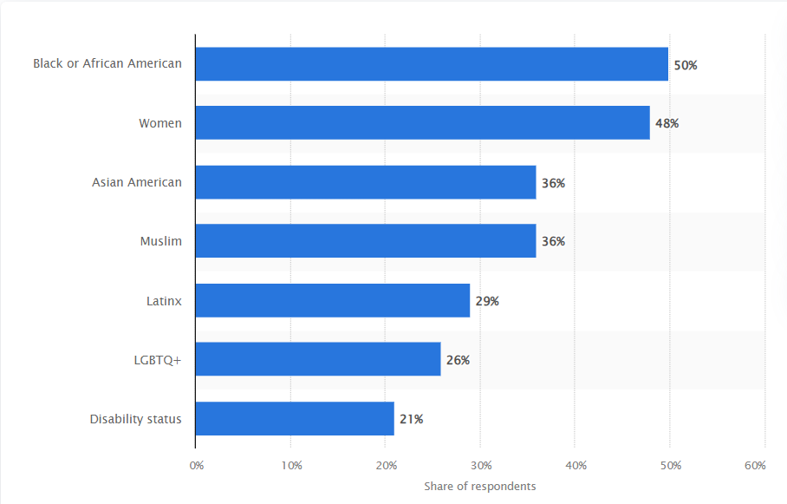
Statistics and Prevalence
Via statista.com About Most common groups experiencing identity-based harassment while playing online games in the United States as of August 2023.

Slide 8
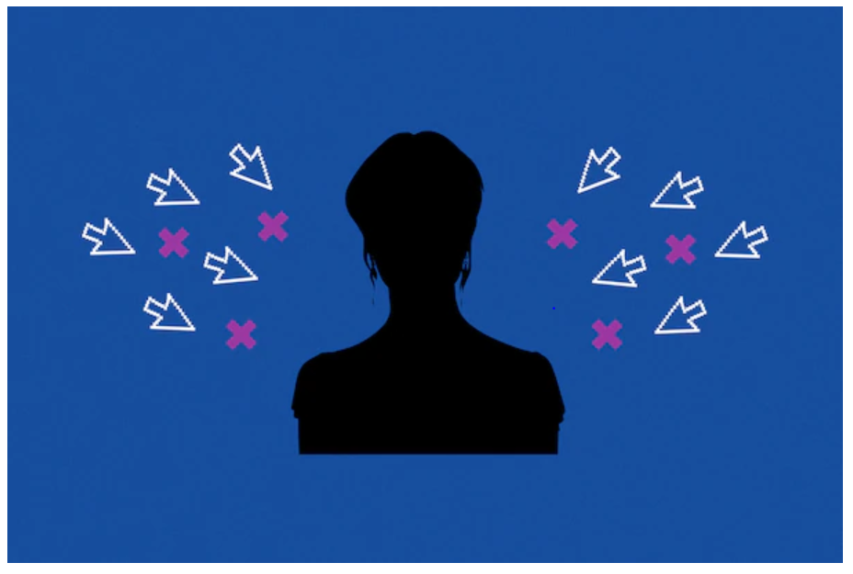
According to eSafety Commissioner, online abuse significantly affects women's mental health and self-esteem.

Slide 9
Credits
zonamovilidad.es
britannica.com
coe.int
un.org
annapolis.gov
eige.europa.eu
esafety.gov.au
dexerto.com
researchgate.net
youthcomm.org
cybersmile.org
statista.com

